Slide 1

Drivers of rents
January 2022
Nam Ngo

Slide 2
Why are we interested in this?
Rent is more closely related to the (wellbeing) outcomes
renters typically pay a larger proportion of their incomes on housing costs compared to homeowners
Rent price could be a better signal of the supply-demand imbalance in the housing market
it reflects the “true” cost of housing consumption and does not include unobservable, non-intrinsic factors like house price

Slide 3
Four main groups of factors have been identified
Supply and demand (imbalance)
Income growth and overall economic condition
Vacancy rate
Interaction between the rental market and the housing market

Slide 4
Overall approach
Identify
Look at long-term potential co-movements between each factor and rental price
Quantify*
Narrow down to a limited set of factors and quantify their contributions through regression?
Notes:
Models: VAR/ Principal component analysis ?

Slide 5
Supply and demand imbalance

Slide 6
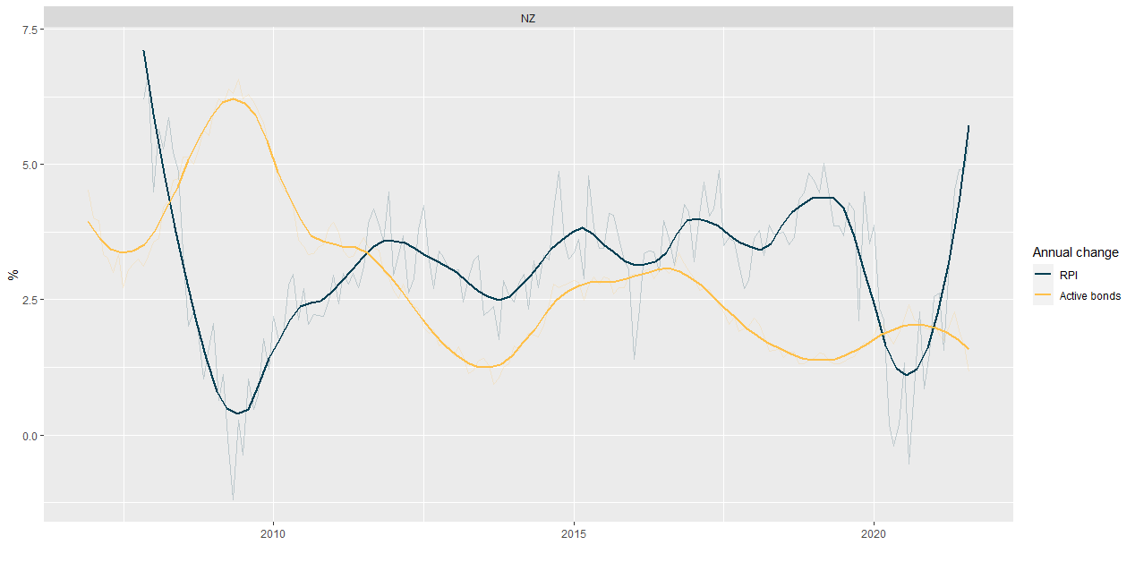
Active bonds growth (as a proxy of rental stock) may not fully reflect supply and demand in the rental market*
Notes:
*Active bonds reflect supply and demand in equilibrium. Excess, unmet demand is hidden (people staying on with families for longer, overcrowding, etc)

Slide 7
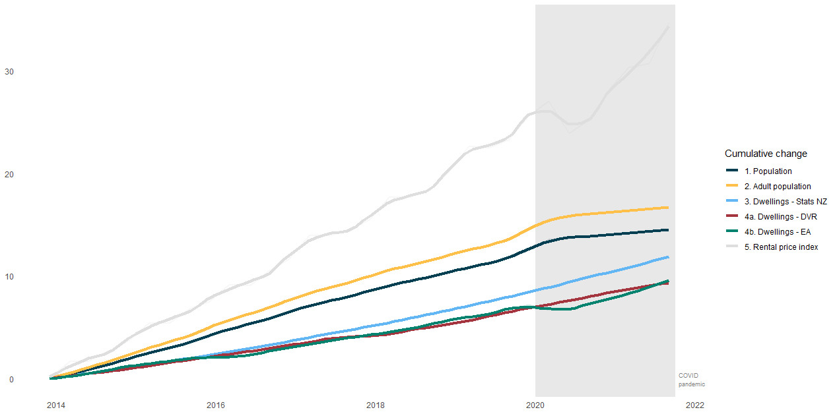
Supply has lagged behind demand for a while and it would take a sustained slowdown in demand for supply to catch up*
Notes:
* Data sources:
Dwelling Stats: Census + new monthly consent (85%) + 9-month lagged
Dwelling DVR: Council data – HUD inhouse series
Dwelling EA: Residential electricity connections – Electricity authority

Slide 8
Income growth and overall economic condition

Slide 9
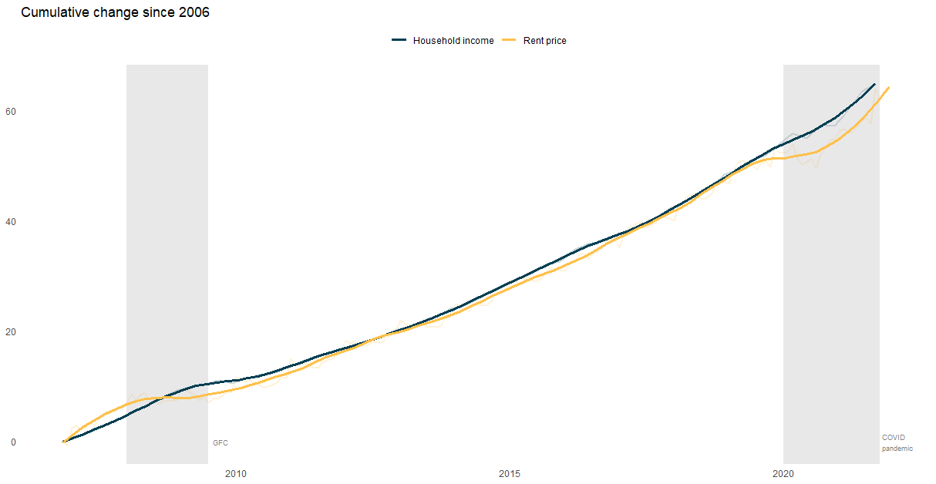
Rent and income have been tracking each other closely for the past 15 years
Notes:
RPI

Slide 10
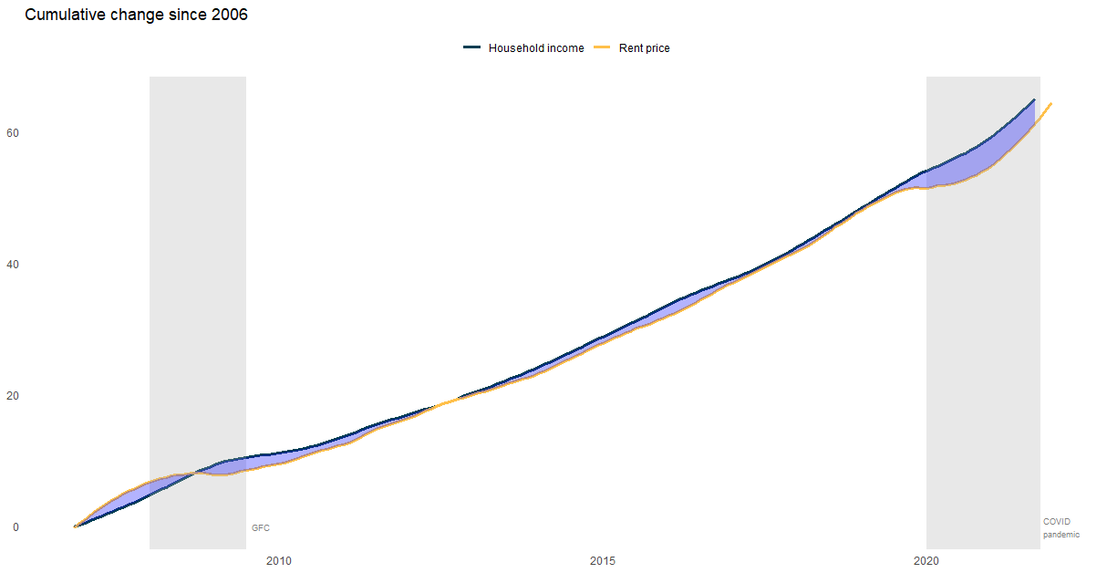
Overtime income tended to increase first and rent followed through
Notes:
It looks like rental affordability has not deteriorated since 2006

Slide 11
Overall, it looks like rental affordability has not deteriorated since 2006
However, the geometric mean (non-quality adjusted measure) of rent shows a little different story

Slide 12
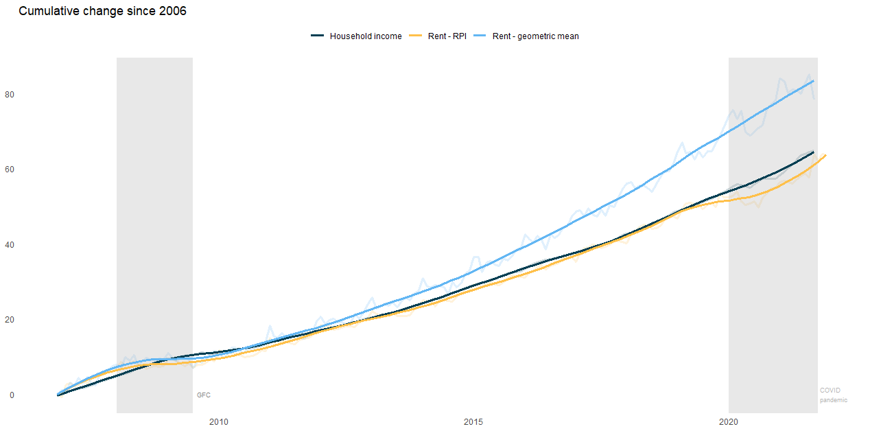
Geometric mean rent has drifted away from median household income since 2012

Slide 13
Several factors contribute to this difference:
Quality adjusted methodology in RPI, i.e isolate pure price change from quality change
Compositional (quality) change in the rental stock over time has forced people to rent a bigger place than they want or need to form bigger households to do so:*
Size of rental properties have increased but size of households have decreased?
Constraint not only in numbers but also in types of available rental properties
Notes:
*It’s ok if people pays more for better quality rental but it’s not if people are forced to pay more due to non-availability of suitable rental properties

Slide 14
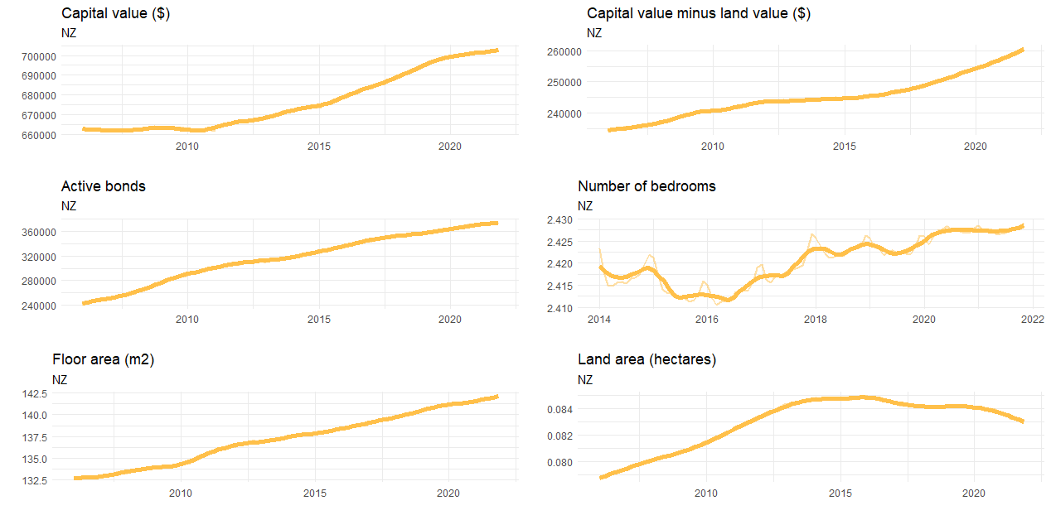
Rental properties have become bigger and have improved in quality over time
Notes:
Link latest capital value/number of bed rooms/Floor area to rental properties (ID)
Mismatch between rental supply and demand

Slide 15
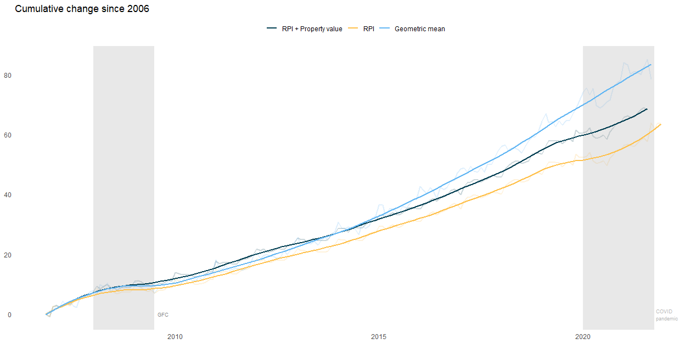
Explicit control of quality improvement cannot explain all the difference => evidence for demand/supply mismatch?

Slide 16
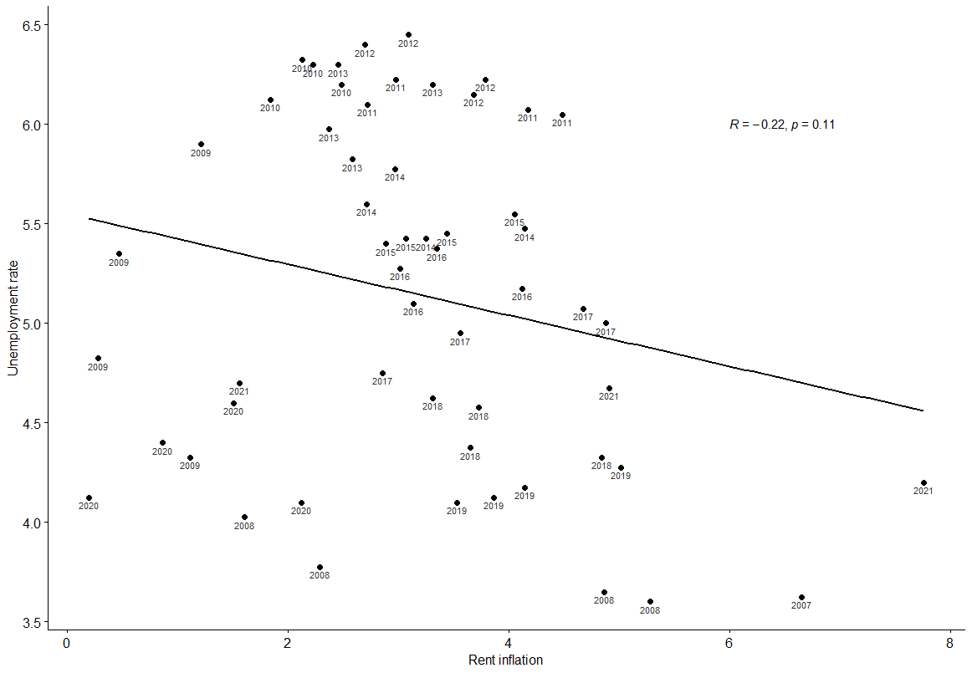
Unemployment (or any other measure of economic outlook) is correlated with rent inflation
Notes:
Quarterly unemployment rate and quarterly rent inflation

Slide 17
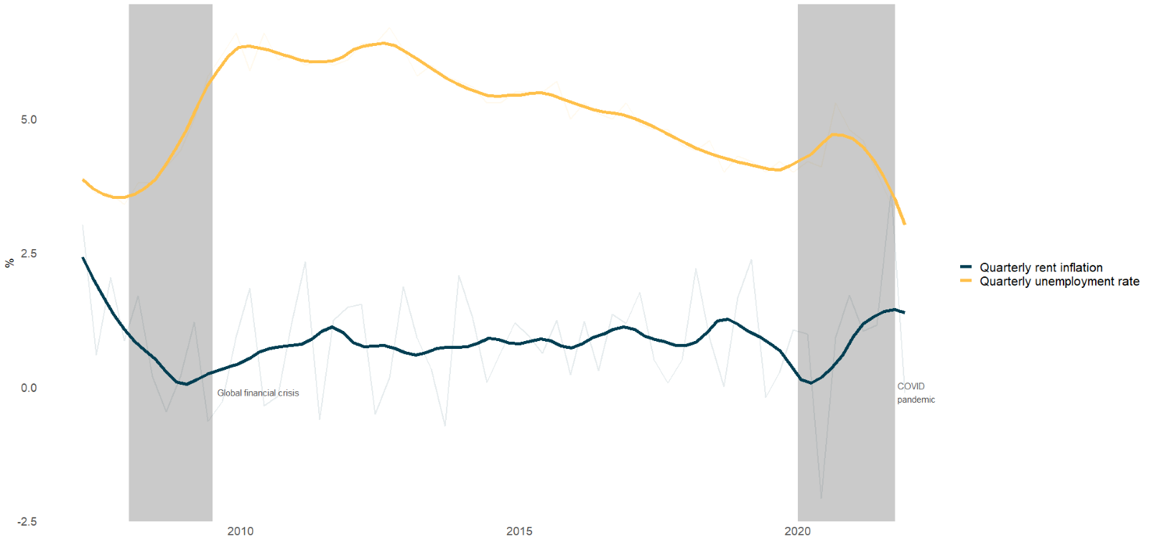
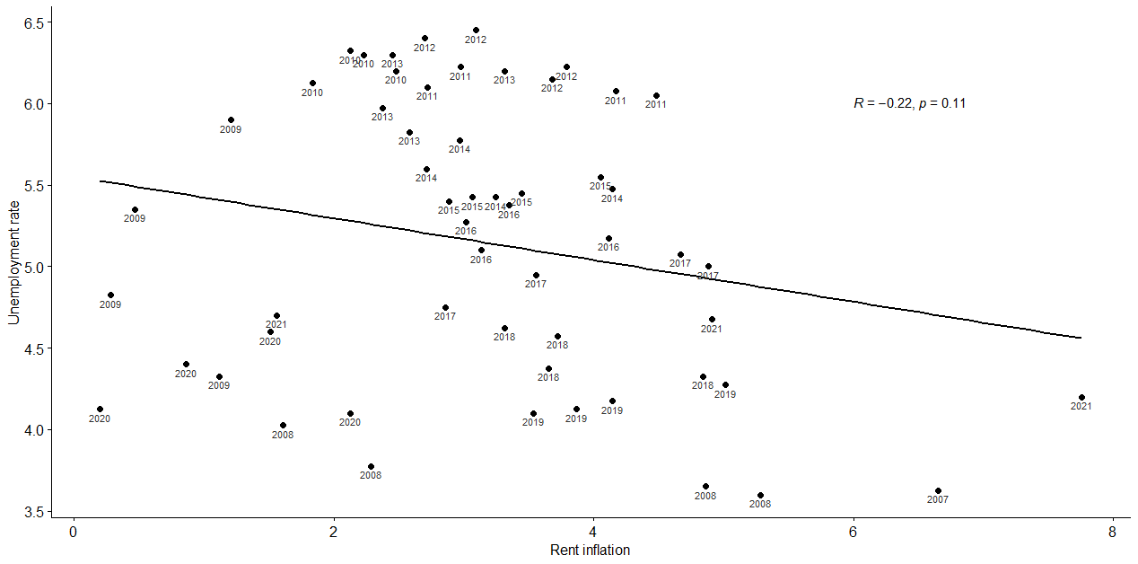
Unemployment (or any other measure of economic outlook) is correlated with rent inflation
Notes:
Quarterly unemployment rate and quarterly rent inflation

Slide 18
Jobs are directly related to renters’ ability to pay
Low unemployment and strong job security may encourage people to form new/smaller households and move away from the current rental situation
=> Additional demand and price pressure

Slide 19
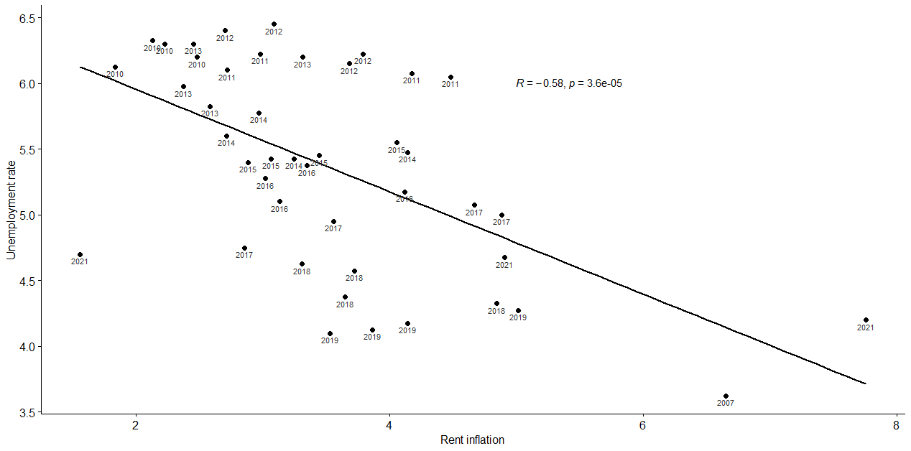
Excluding 2008/2009 and 2020 strengthen the negative correlation

Slide 20
Vacancy rates

Slide 21
Vacancy rates is the proportion of the rental stock that is vacant for rent
Similar to unemployment rate in the labour market
High vacancy rates would drive rental price down and vice-versa
Notes:
Vacancy rate is similar to unemployment rate in the labour market

Slide 22
Methods to measure vacancy rate overseas vary
US: Housing vacancy survey
Australia: Online listings/established rental properties
Can we construct a proxy measure using bonds and Trade Me data?
Notes:
https://www.census.gov/housing/hvs/files/currenthvspress.pdf

Slide 23
#1: Time between tenancies
Link bond data and properties ID to identify change in tenancy
Filter out properties that have not been tenanted for 2 prior years *
Calculate the median time that the newly rented properties have been vacant
Notes:
* Only looking at properties that have always been rental

Slide 24
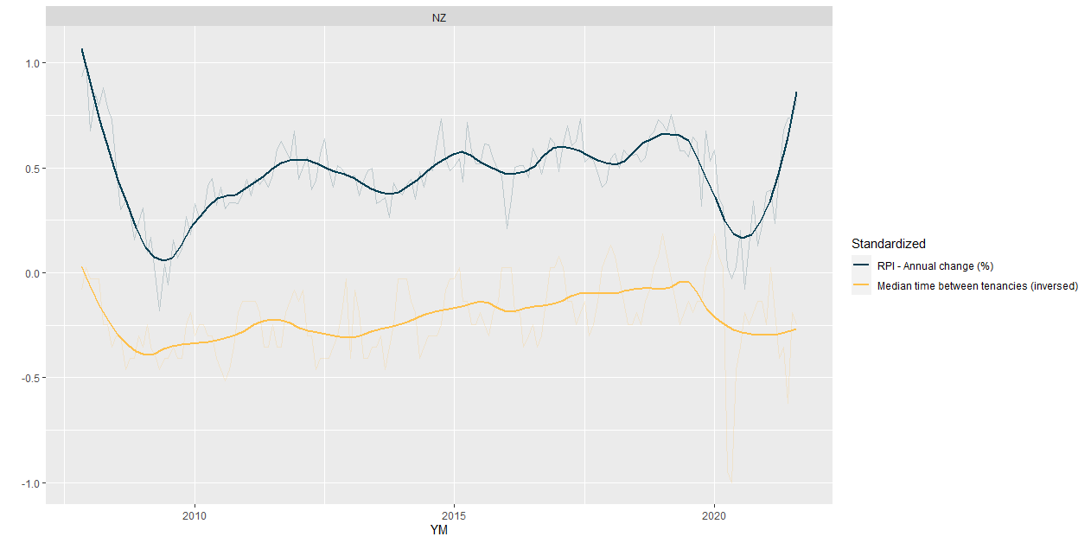
Shorter time between tenancies => lower vacancy rate
Notes:
Historical average: Around 11-20 days

Slide 25
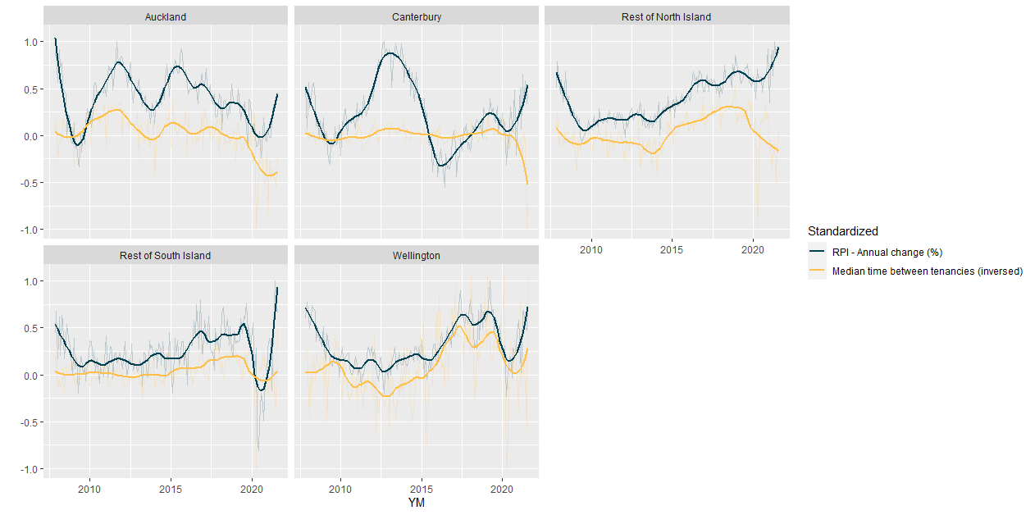
Shorter time between tenancies => lower vacancy rate

Slide 26
#2: Trade Me new listings
Vacancy rate = Monthly TM listings / Monthly active bonds
Dependent on Trade Me market share over time
Notes:
TM listings = vacancy indicators

Slide 27
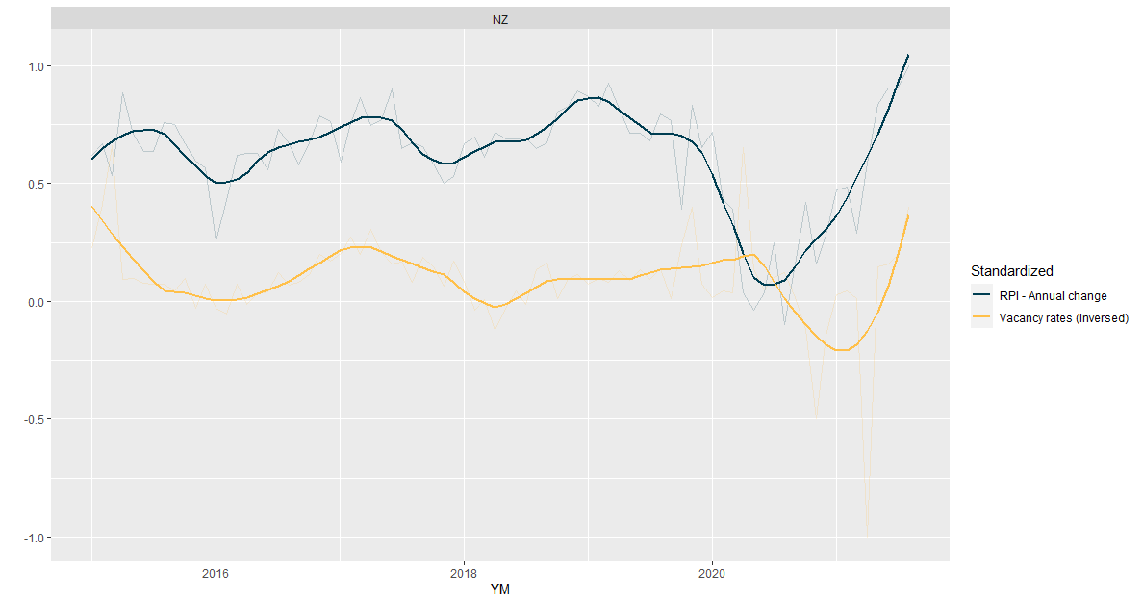
Lower vacancy rate
Notes:
NZ: 3.4; Auckland: 3.9; Canterbury: 4.4; RNI: 2.3; RSI:3.1Wellington:3.8
Aus: 2-4%
US: 5.5 – 7%

Slide 28
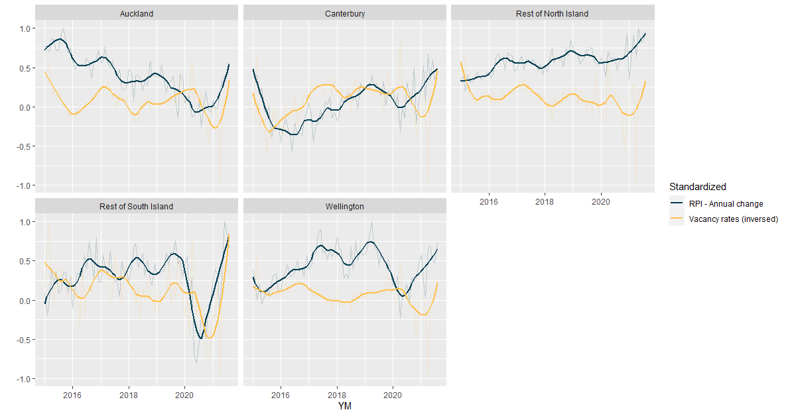
Lower vacancy rate

Slide 29
#3: Other measures
Median days on the market (Trade Me’s market share)
Explicitly count the number of rental properties through the bond system that are not rented out (How can we identify properties that have always been rental*?)
Notes:
i.e not recently sold and have appeared in the bond system before?

Slide 30
Interaction between the rental market and the housing market

Slide 31
The housing and rental market have a common product
Rental/Housing market as step-based
Young/Lower income people: Rent + build up deposit to enter the housing market
If the barriers of entry in the housing market is higher, demand for rental properties would increase too
Renters with higher income compete and drive rental prices up
House value increase may incentivize landlords to raise rent*
Notes:
*Landlords consider selling properties for capital gains vs. raising rent

Slide 32
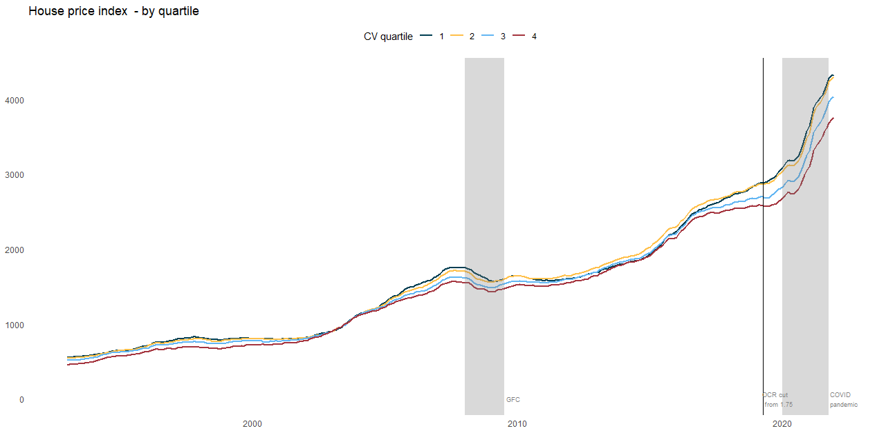
Price has increase more for houses at the lower quartile
Notes:
House price index by capital value

Slide 33
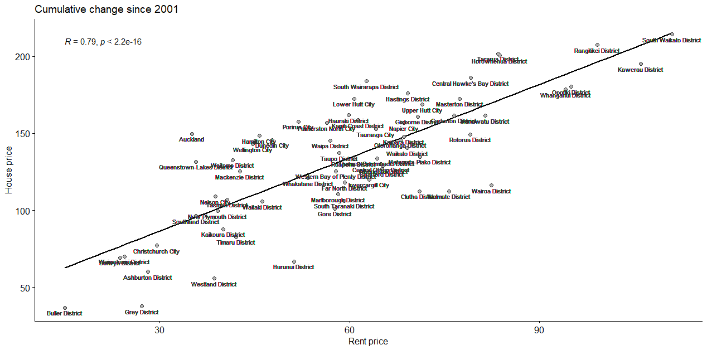
At TA level, house price and rental price increases for the past 20 years are highly correlated
Notes:
Cumulative change in rental and house price since 2001

Slide 34
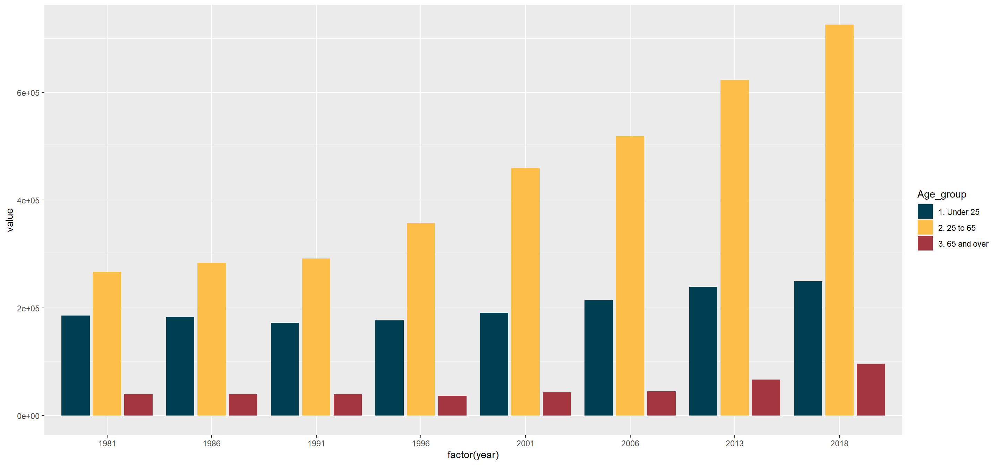
Working age renters have increased significantly more*
Notes:
Barriers of entry in the housing market

Slide 35
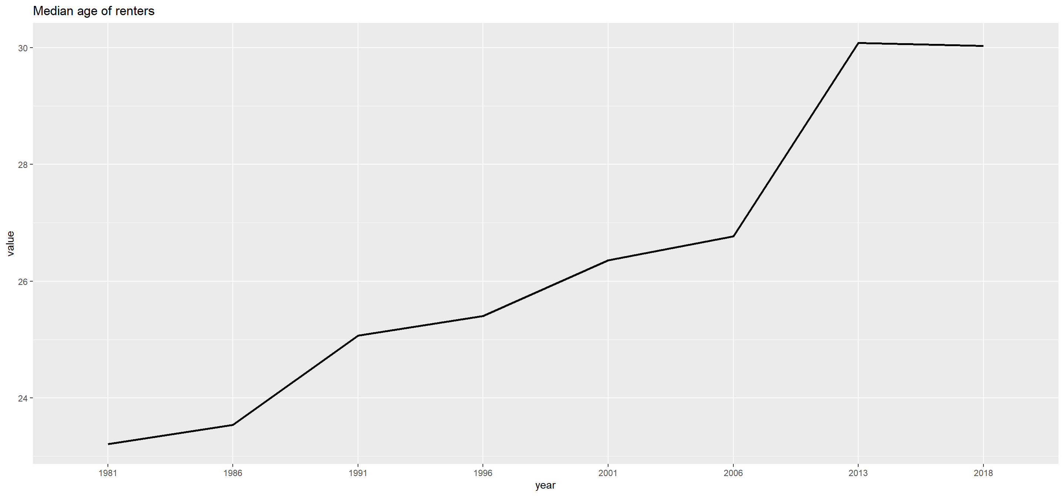
Renters are older and therefore have higher income/ability to pay

Slide 36
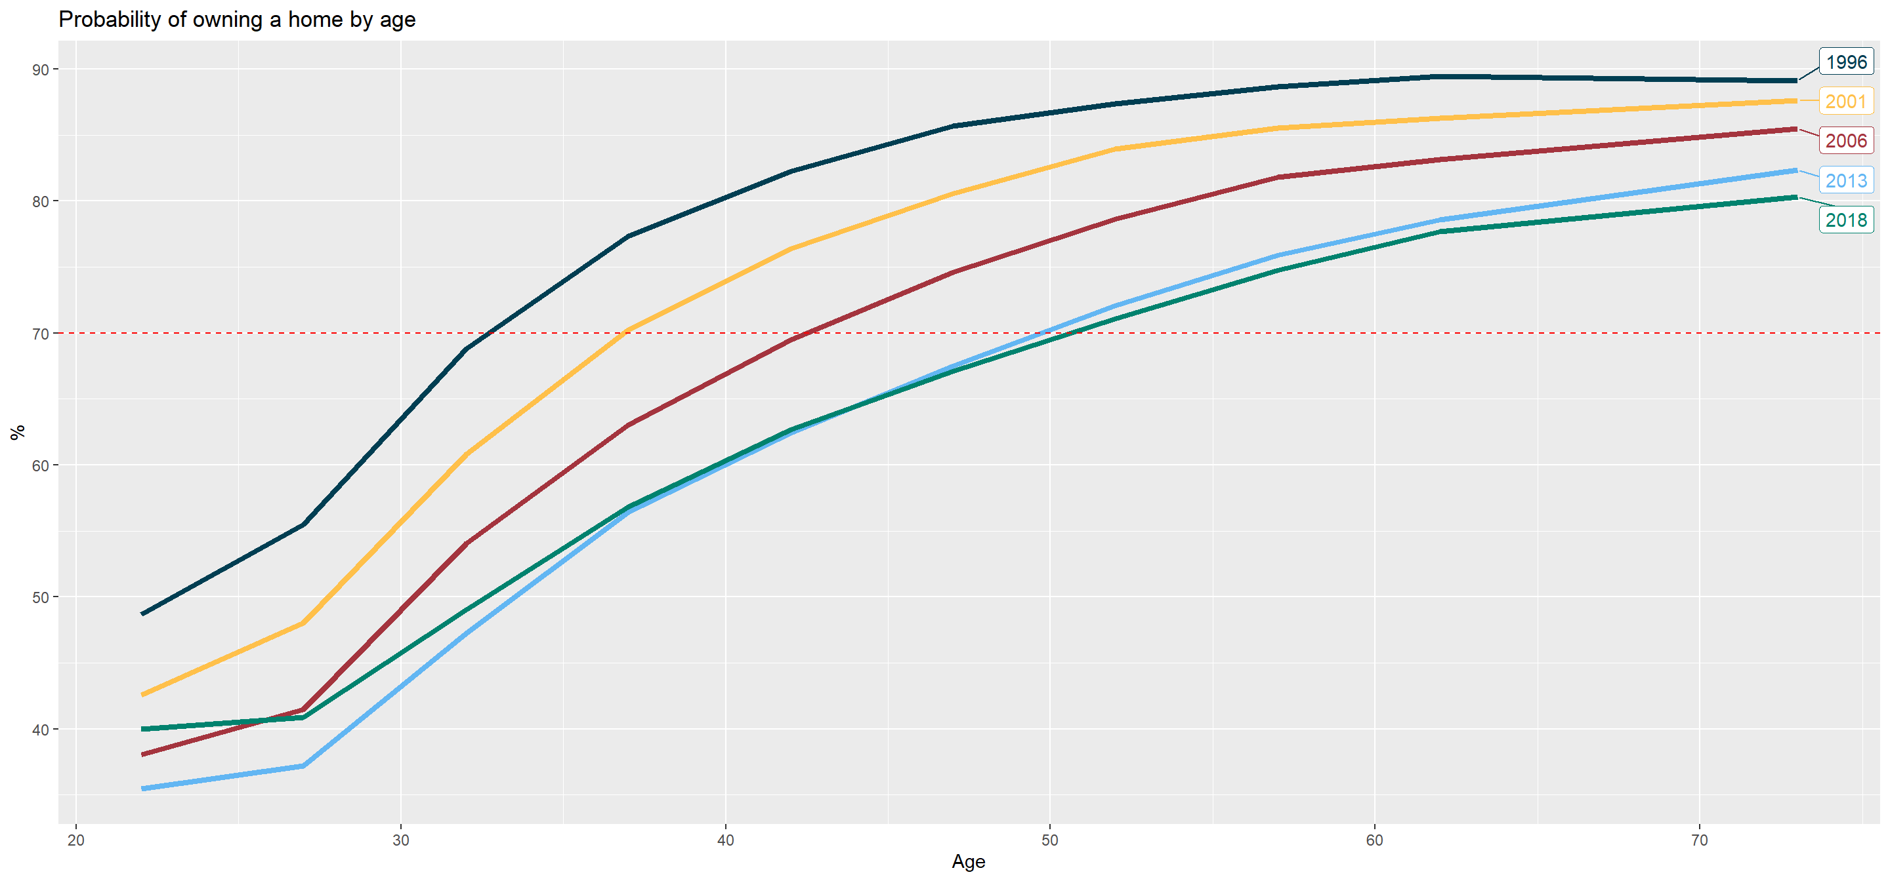
Home ownership rate have deteriorated for young people*
Notes:
20 more years of renting with increasing income

Slide 37
Next steps
Solidify the measure of vacancy rate
Consider the relationship between household formation and rental inflation, subjecting to data availability
Quantify the contribution of each factors
Apply the framework to regional/TA level
Notes:
IDI

Slide 38
Questions and feedbacks

